Slide 1
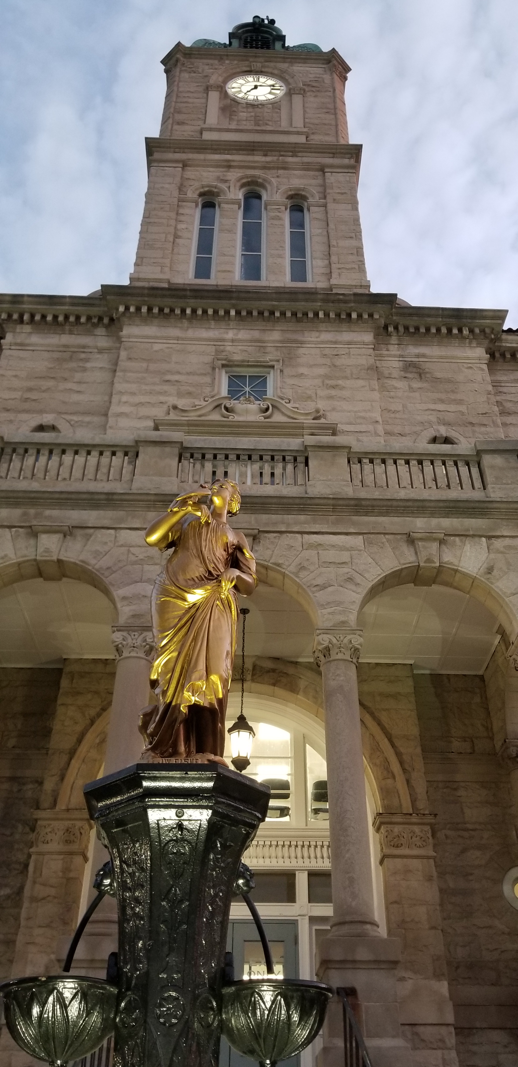
Public Defenders Office Survey Results
Prepared for the Rockingham – Harrisonburg Community Criminal Justice Board (CCJB)
Prepared by the CCJB Committee on Public Defense
January 9, 2023

Slide 2
Public Defense Committee Members
Richard Jackson – Chairperson
Stephen King
Ande Banks
Christopher Bean
Gene Hart
S. Frank Sottaceti – Staff / Analyst

Slide 3
Profession Categories
Defense Counsel
Commonwealth Attorneys Office
Pretrial, Probation, and Parole
Judges
Law Enforcement

Slide 19
WAS THE FEE CAP WAIVER APPROVED?

