Slide 1
Rockingham Harrisonburg
Justice & mental health collaboration:
Findings and recommendations
Presented to the Harrisonburg/Rockingham Community Criminal Justice Board
April 3, 2023

Slide 2

overview
2019 $750,000 BJA JMHCP award
Goals:
  Strengthen collaboration between law enforcement and behavioral health
  Develop effective and efficient law enforcement and community-based responses to individuals with mental illness and co-occurring mental illness and substance abuse (MI/CMISA)
  Improve community safety
Currently in fourth and final grant year
Findings and recommendations from the first three years

Slide 3
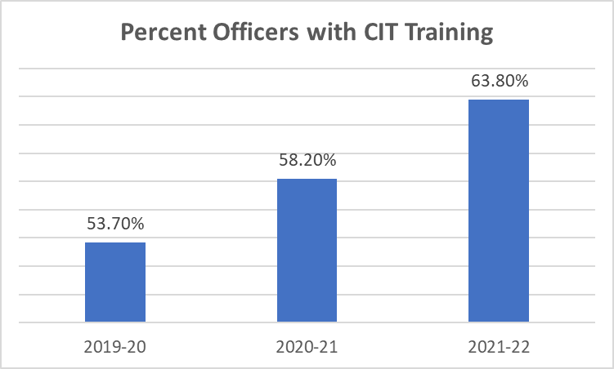
CIT Training Expansion
Train at least 50% of all new or never previously trained officers.
Increase agency training overall by 5%, with an emphasis on units with less than 25% trained personnel.
  Observed 15% increase overall
Offer CIT refresher courses focusing on advanced topics to all eligible officers.
Train a total of 265 officers over the three-year grant period.
  193 individuals trained to date (72%)
  Exceeded estimated training hours by over 2,000 hours

Slide 4
Enhanced CIt training measures
Program Effects (n = 75)
 | Baseline | Follow-Up | Mean Diff. | t | d
 | Mean (SD) | Mean (SD)
VA CIT Coalition Knowledge and Awareness (Sum) (n = 103) | 2.64 (.7) | 4.27 (.46) | 1.63 | 25.30*** | .65
Self-Efficacy (n = 71) | 3.00 (.42) | 3.78 (.21) | .81 | 18.10*** | .37
Referral Skills (n = 83) | 3.51 (.25) | 3.81 (.18) | .29 | 8.10*** | .25
De-escalation Skills (n= 83) | 3.33 (.26) | 3.60 (.17) | .27 | 9.20*** | .26
Knowledge | .30 (.17) | .30 (.17) | .00 | 1.17 | .03
Participant CIT Satisfaction (Scale 0-10)​
Traumatic Brain Injury​ | Issues with Aging​ | Children and Adolescence​ | Helping Veterans​ | Community Resources​ | Officer NeedsAssistance​
8.85​ | 8.09​ | 8.76​ | 9.15​ | 9.0​ | 9.3​

Slide 5
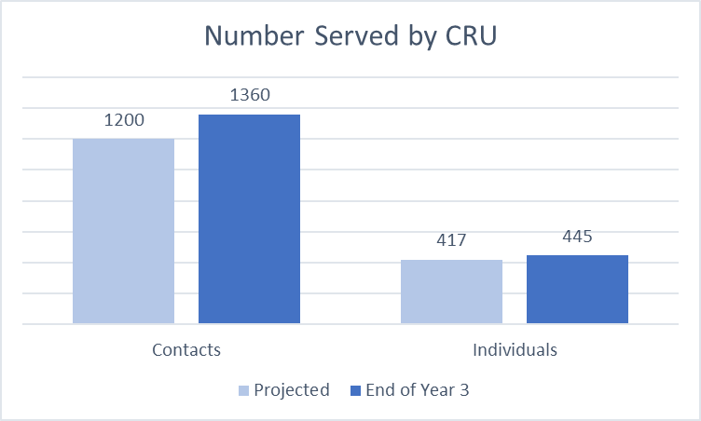
Co-Response Unit (CRU) Expansion
Addition of full-time CRU to existing part-time team:
First responder support
Wellness checks
Short-term follow-up
Emergency case management

Slide 6
CRU Program Referral Sources
Referral Source | N | Total | 2019-2020 | 2020-21 | 2021-2022
RHRJ Facility | 25 | 3.7% | 2.3% | 6.8% | 1.2%
CSB | 318 | 47.3% | 58.1% | 47.1% | 46.1%
Court Services | 38 | 5.7% | 4.7% | 6.1% | 5.4%
Law Enforcement | 120 | 17.9% | 14% | 24.1% | 12.9%
Dispatch | 26 | 3.9% | 4.7% | 5.1% | 2.7%
CFS follow-up | 94 | 14% | 0% | 4.4% | 24.3%
Other | 51 | 7.5% | 16.3% | 6.4% | 7.5%

Slide 7
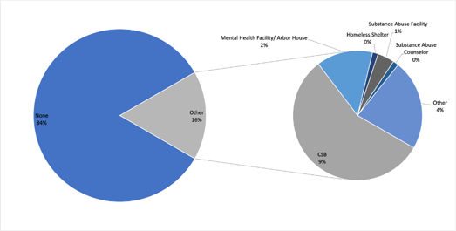
CRU Referrals to Services

Slide 8
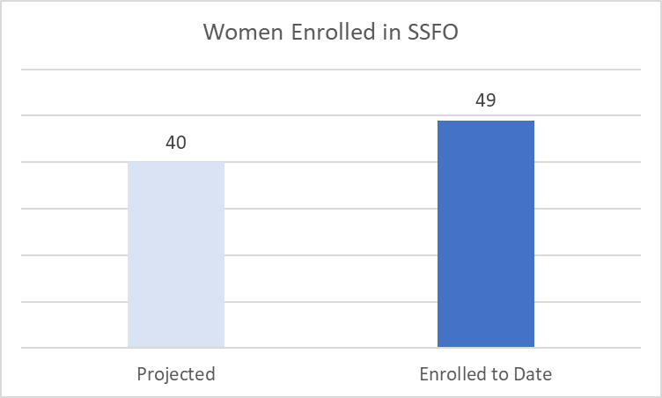
Specialized services for female offenders (SSFO) Program
Expanded services for high risk/high need female offenders with MI/CMISA
Partnership with Gemeinschaft Home women's program
Enhanced supervision and treatment, including residential housing
Surpassed program targets
Low completion rates

Slide 9
Bureau of justice Assistance Information & Data sharing Objectives
“Information sharing within and across criminal justice and behavioral health treatment agencies to make eligibility determinations, and ensure direct connections to treatment services in the community. For law enforcement this could include developing or enhancing computerized information systems to provide timely information to law enforcement and other criminal justice system personnel to improve the response to incidents involving people with MI and CMISAs, and which fosters the systematic analysis of incidents involving people with MI and CMISAs.” (BJA, 2019,p 8)

Slide 10
Information & data sharing
Developed a newly designed project database (IMS) to track CIT training completion and CRT case management (implemented Feb 2020). Featured in a Council of State Governments congressional subcommittee session and has been instrumental to grant success.
1) Peer Learning;
2) Review of data collection systems;
3) Expanding outcome tracking across systems;
4) Present and disseminate findings.

Slide 11
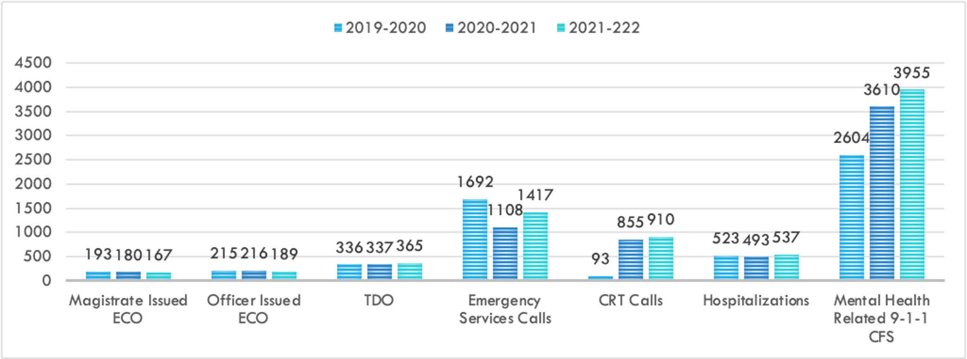
Regional Mental Health Crisis Trends

Slide 12
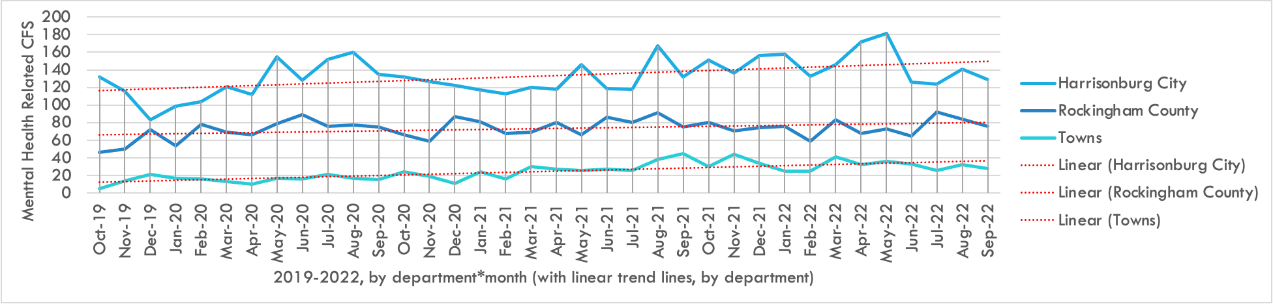

Mental Health Call Volume by Month

Slide 13

Research Findings
(Handout)
Increasing MH Crisis-Related Call Volume by Call Type Provided Insights to Changing Community Needs
Trends in arrests made on Mental Health-related CFS
Trends leading to congestion of the CITAC
Comparative analysis of response units to mental health-related calls and follow-ups

Slide 14

Program
Recommendations
CIT Training
  Increase refresher and advanced training
  Continue to track training rates across departments
Co-Response Unit
  Increase response to 911 MH and MH follow-up calls
  Increase prescreening in the field to divert from hospitalization.
  Increase rate of referrals on calls
  Reduce short-term case management

Slide 15

Data& Evaluation
Recommendations
Review CRU assessment tools and practices, prioritize individuals with moderate or high risk (e.g., mental health field assessment, SMI, ORAS) and high system utilizers.
Sustain current tracking efforts.
Expand utilization of systematic data to track point of service information related to mental health crisis.
Build and expand cooperative agreements.
Continue peer learning.

Slide 16
Filling other program gaps
In response to capacity findings indicated wait times on involuntary transports (10+ hours)
  Expand CITAC law enforcement coverage to reduce officer wait times.
Increase options for diversion to community-based crisis response.
  Treat individuals in least-restrictive environment
  Reduce utilization of CITAC to those most in need
Increase systematic MH follow-up from CITAC, jails, SSFO, and state hospitals.
Increase planning and coordination through cross-systems intercept mapping.

Slide 17
ATTACHMENTS

Slide 18
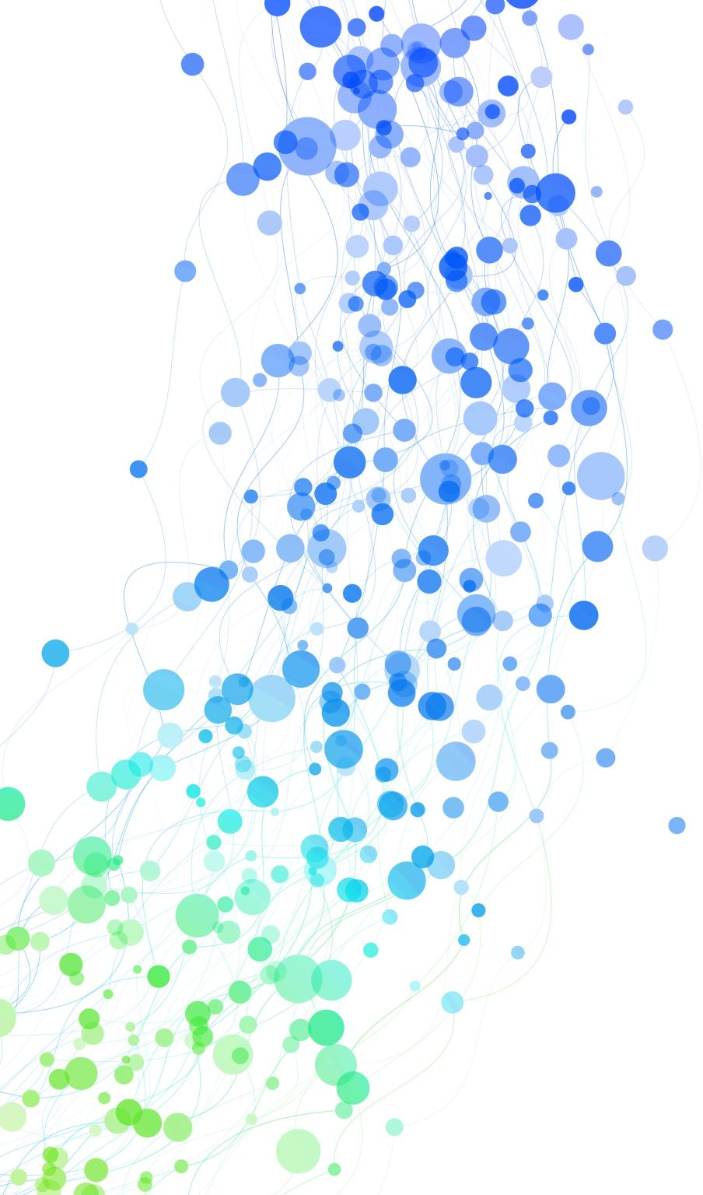
Mental Health Crisis Call Outcomes Among CIT Officers:
Challenges and Consequences for Citizens in Rural Areas
Presented at the 2023 Southern Political Science Association Annual Meeting
Amanda Teye, Ph.D. & Liliokanaio Peaslee, Ph.D.
James Madison University

Slide 19
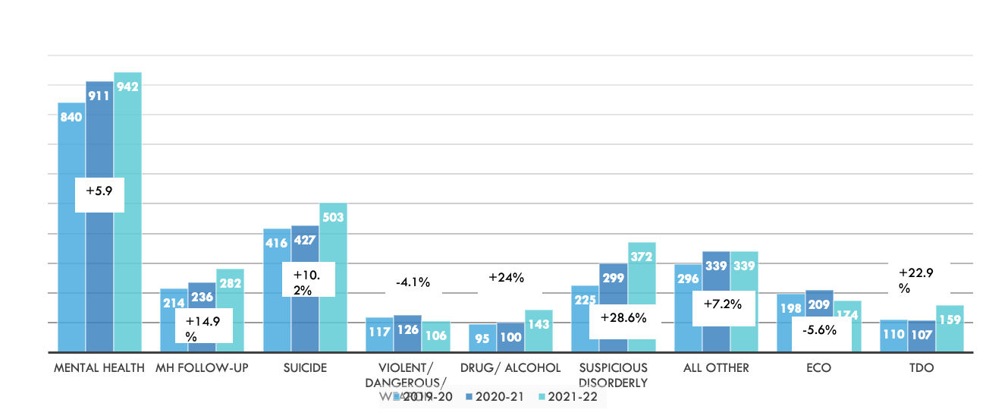
Increasing CFS Volume

Slide 20
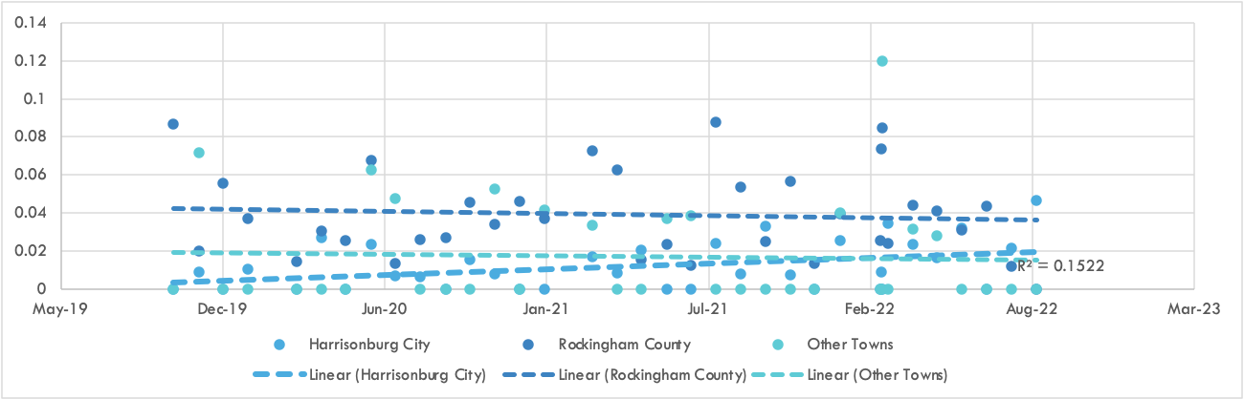
Increasing Arrest Volume
The overall arrest rate of 1.3% on mental health-related calls. Observed MH arrest rate in the study region are similar to other areas. According to recent research findings, the average rate of arrest on mental health calls ranged from 0.5-3.0% (Lum, Koper, & Wu, 2022). However, trends show a 52% increase in area wide mental health-related arrests from Year 1, indicating a positive growth trend.

Slide 21
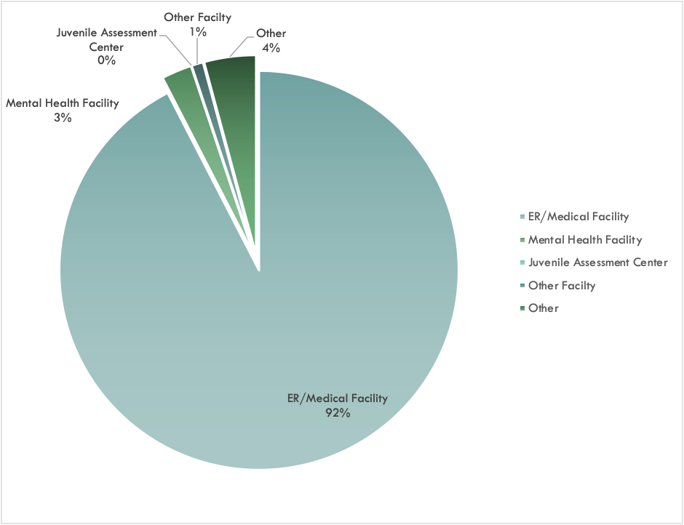
Voluntary Transport Locations

Slide 22
Results: CFS Outcomes by Response
Rate% (Adj. Res.) | Left On Site | Voluntary | Involuntary Transport | Arrest
Non-CIT | 74.7% (-2.1) | 22.3% (1.9) | 2.7% (.9) | .2% (.1)
CIT | 76.6% (-1.8) | 20.5% (1.1) | 2.6% (1.9) | .2% (.3)
CRU | 84% (4.6) | 15.3% (-3.4) | .6%. (-3.4) | .1% (-.5)
RQ2: A simple comparison does not account for call type differences as well as departmental and time of day effects. When controlling for call type, isolating MH and MH follow-up calls (As Shown in Table), we continue to observe effects on dispositional outcomes CRU officers were ((X2 (1, 9017) = 156.7, p = .001).

Slide 23
Results
Mental Health/Mental Health Follow-Up Program Effects (Cohen's d (C.I.))
 | Non-CIT to CIT | Non-CIT to CRT | CIT to CRT
Voluntary v. left on site | .05 (-.03 - .12) | .19 (.09 - .29) | .15 (.06 - .23)
Involuntary v. left on site | .01 (-.07 - .1) | .19 (.08 - .31) | .16 ( .07 - .25)
Arrest v. left on site | .001 (-.08 - .08) | .02 ( -.08 - .14) | .02 (-.06 - .11)
Effect Size Cut-off Small .2, Moderate, .5, Large .8

