Slide 1
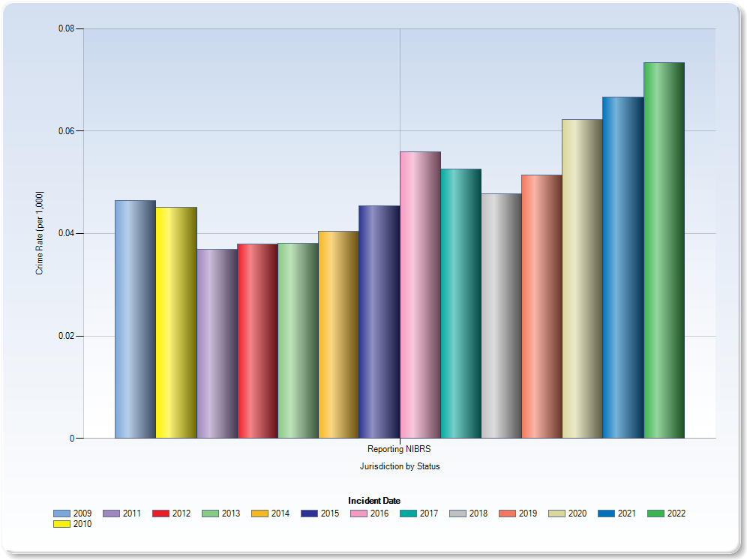
Murder & Nonnegligent Homicide Crime Rate per 1,000

Slide 2
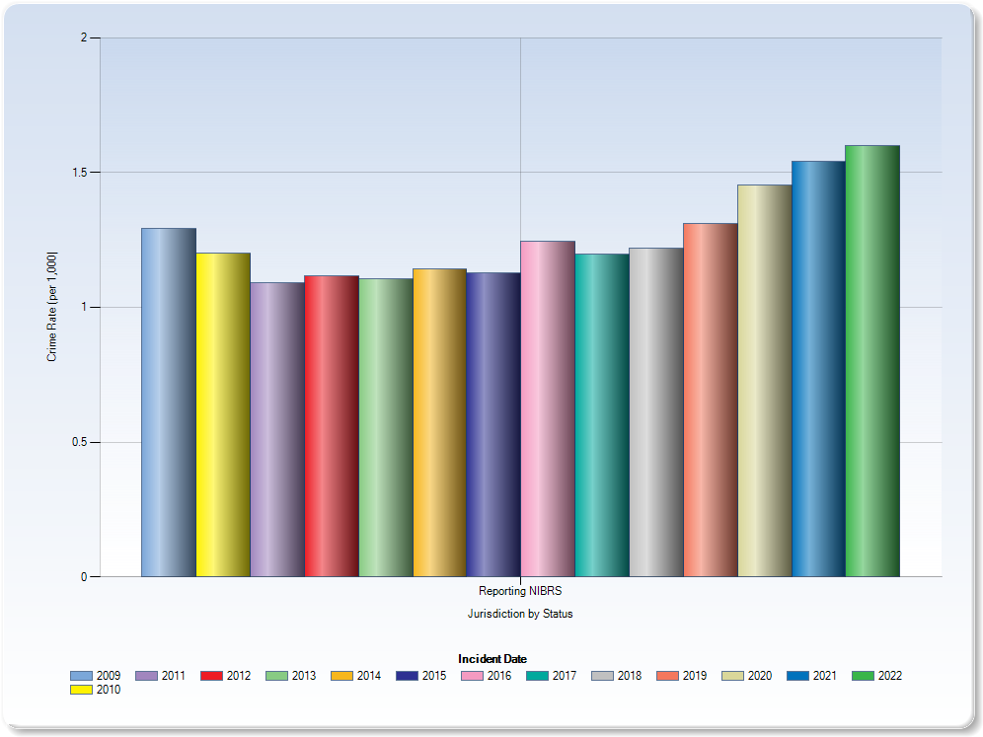
Aggravated Assaults Crime Rate per 1,000

Slide 3
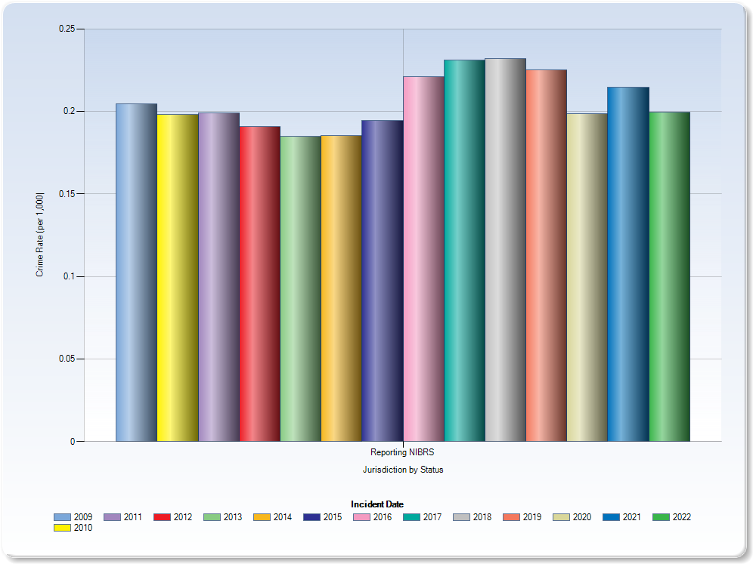
Rape Crime Rate per 1,000

Slide 4
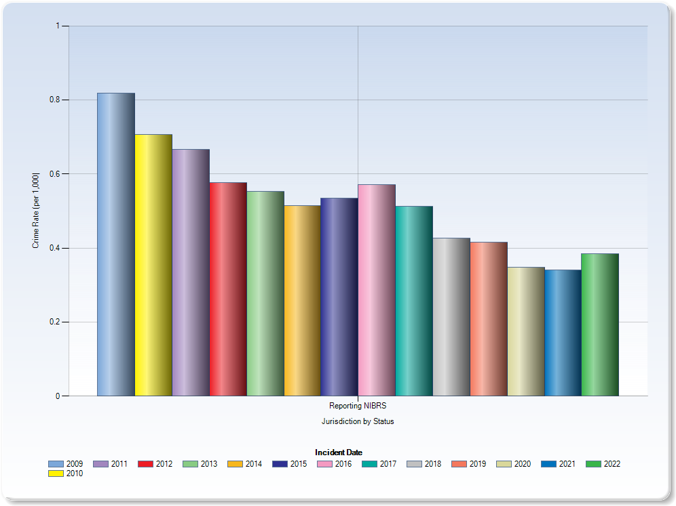
Robbery Crime Rate per 1,000

Slide 5
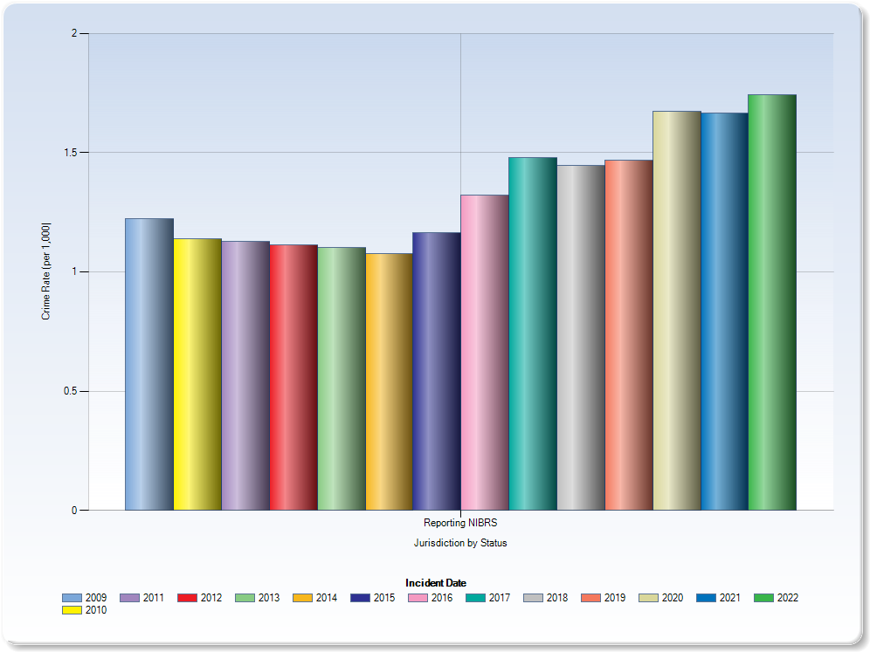
Weapons Law Violations Crime Rate per 1,000

Slide 6
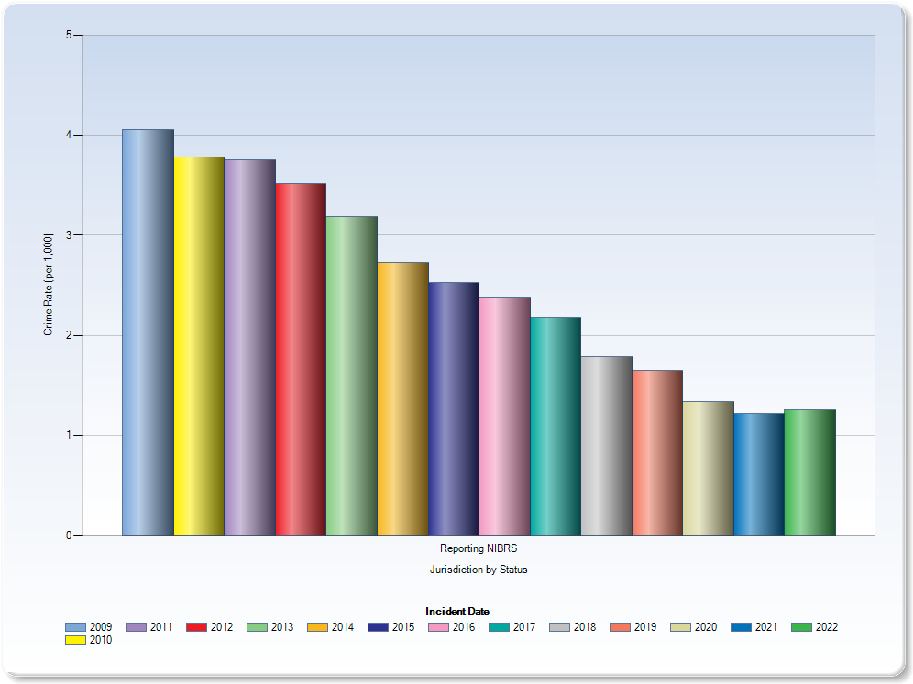
Burglary Crime Rate per 1,000

Slide 7
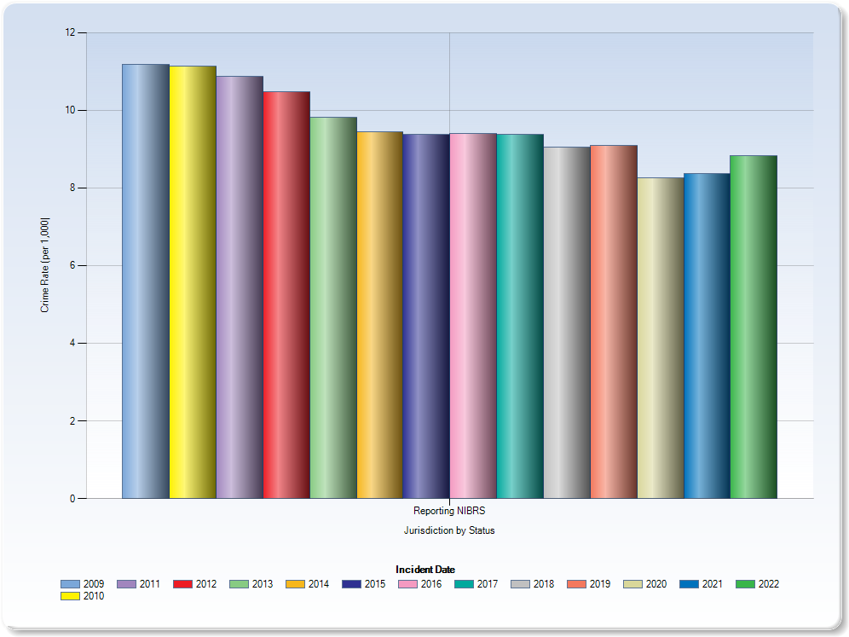
Simple Assault Crime Rate per 1,000

Slide 8
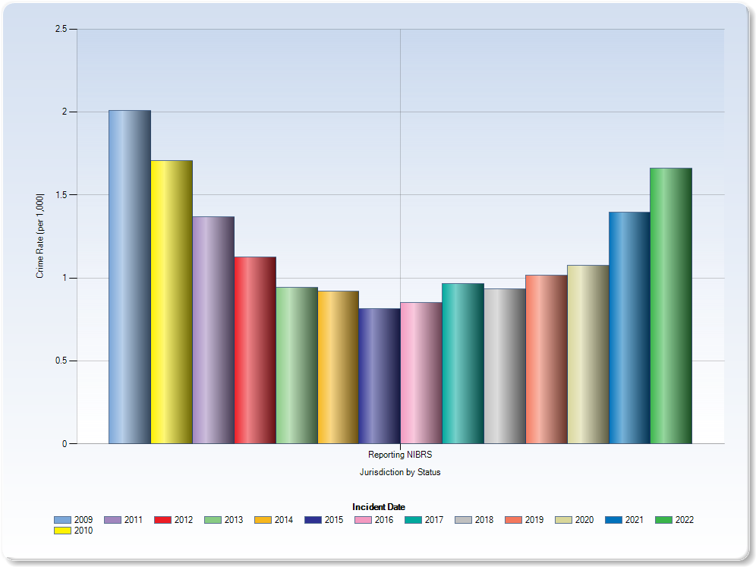
Theft of Motor Vehicle Parts Crime Rate per 1,000

