Slide 1
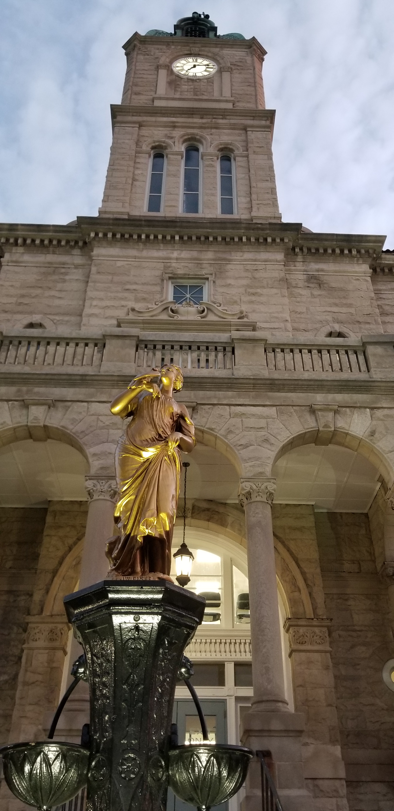
Public Defenders Office Exploratory Committee
Prepared for the Rockingham – Harrisonburg
Community Criminal Justice Board (CCJB)
Prepared by the CCJB Committee on Public Defense
July 10, 2023

Slide 2
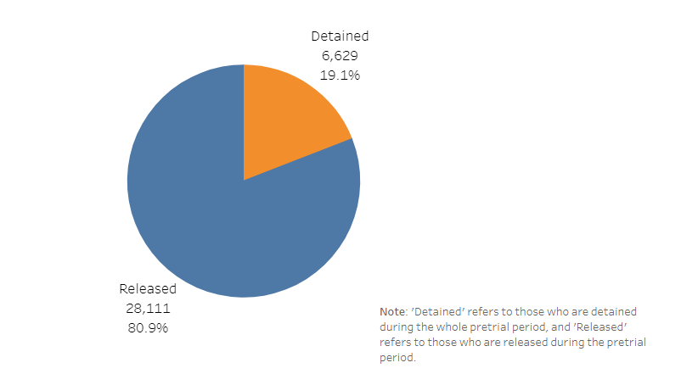
Commonwealth of Virginia
Court Appointed
Pretrial
Source –
VA Criminal Sentencing Commission

Slide 3
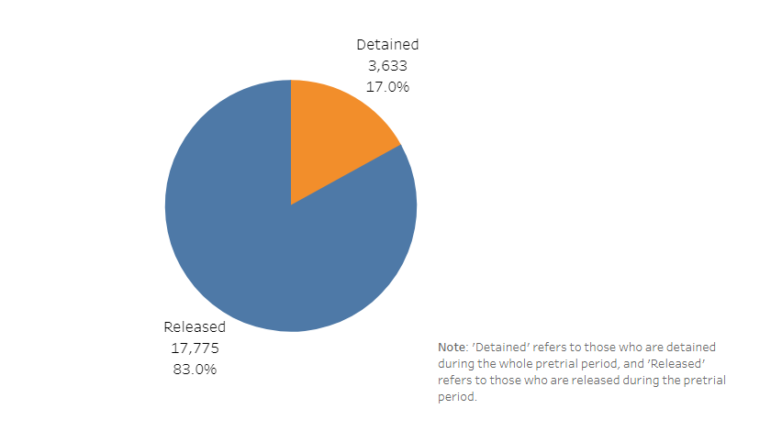
Commonwealth of Virginia
Public Defenders Office
Pretrial
Source –
VA Criminal Sentencing Commission

Slide 4
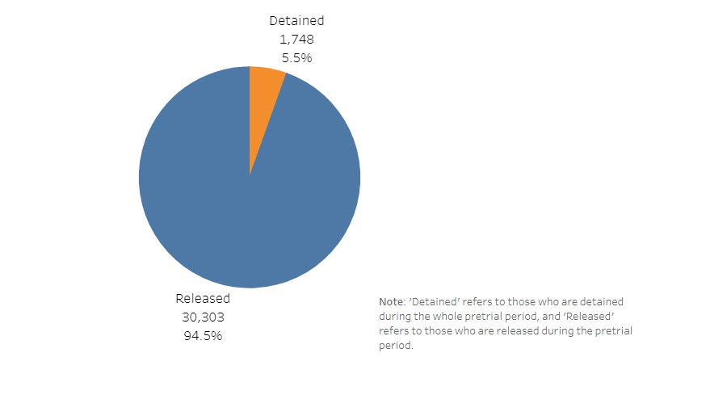
Commonwealth of Virginia
Retained by Client
Pretrial
Source –
VA Criminal Sentencing Commission

Slide 5
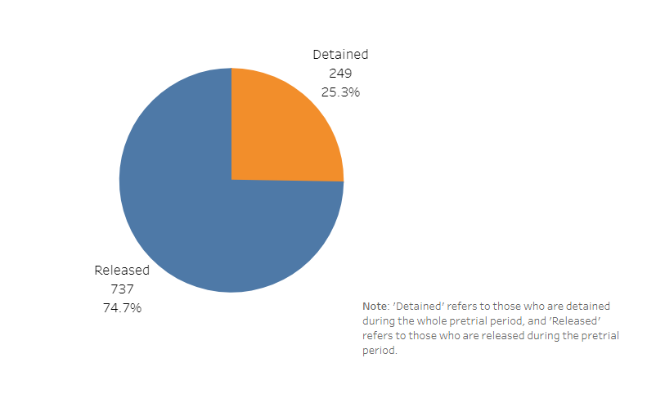
Counties of Clarke, Frederick, Page, Shenandoah, and Warren, and the City of Winchester *
Court Appointed Counsel
Pretrial
Source –
VA Criminal Sentencing Commission

Slide 6
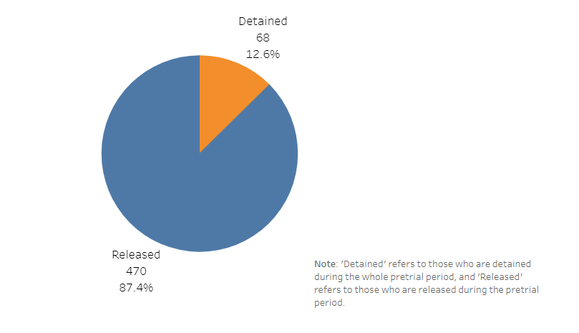
Counties of Clarke, Frederick, Page, Shenandoah, and Warren, and the City of Winchester *
Public Defenders Office
Pretrial
Source –
VA Criminal Sentencing Commission

Slide 7
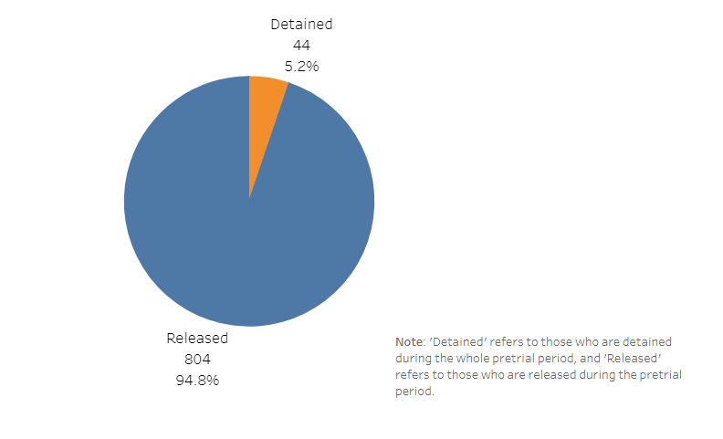
Counties of Clarke, Frederick, Page, Shenandoah, and Warren, and the City of Winchester *
Retained by Client
Pretrial
Source –
VA Criminal Sentencing Commission

Slide 8
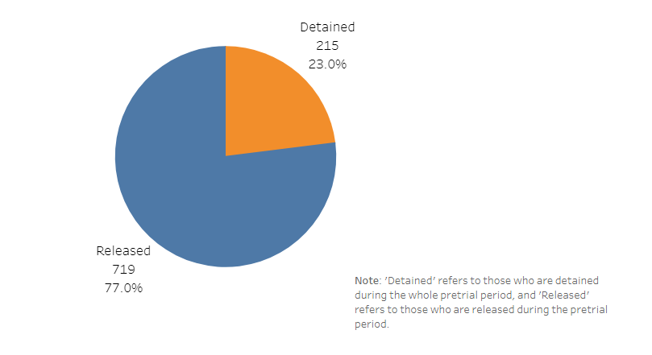
Harrisonburg / Rockingham County
Court Appointed Counsel
Pretrial
Source –
VA Criminal Sentencing Commission

Slide 9
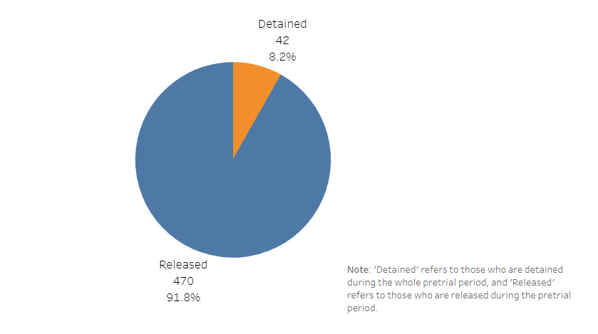
Harrisonburg / Rockingham County
Retained by Client
Pretrial
Source –
VA Criminal Sentencing Commission

Slide 10
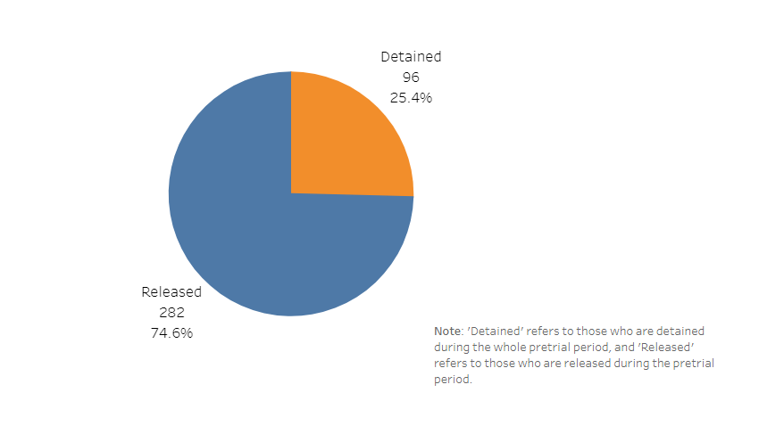
Cities of Buena Vista, Lexington, Staunton, and Waynesboro and the Counties of Augusta and Rockbridge *
Court Appointed
Pretrial
Source –
VA Criminal Sentencing Commission

Slide 11
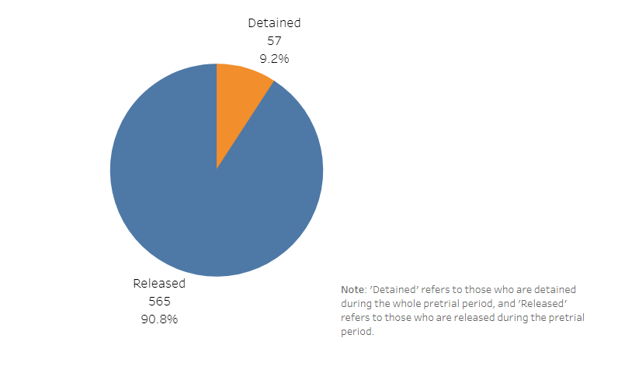
Cities of Buena Vista, Lexington, Staunton, and Waynesboro and the Counties of Augusta and Rockbridge *
Retained by Client
Pretrial
Source –
VA Criminal Sentencing Commission

Slide 12
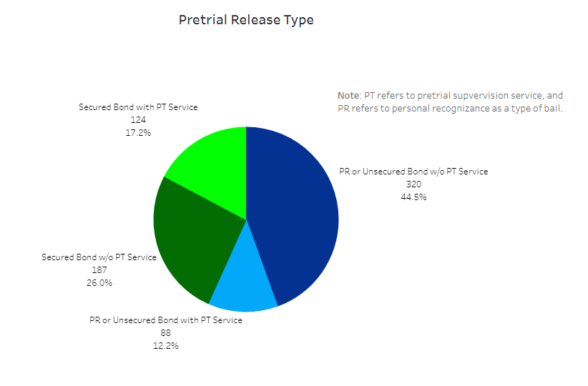
Harrisonburg / Rockingham County
Court Appointed
Pretrial
Source –
VA Criminal Sentencing Commission

Slide 13
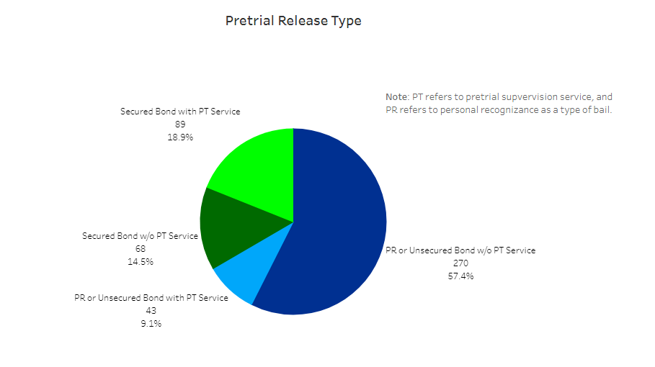
Harrisonburg / Rockingham County
Retained by Defendant
Pretrial
Source –
VA Criminal Sentencing Commission

Slide 14
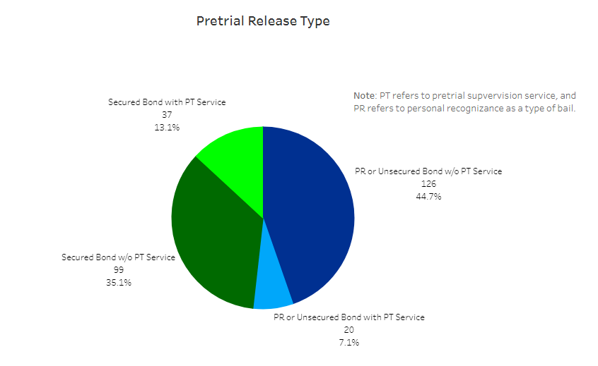
Cities of Buena Vista, Lexington, Staunton, and Waynesboro and the Counties of Augusta and Rockbridge *
Court Appointed
Pretrial
Source –
VA Criminal Sentencing Commission

Slide 15
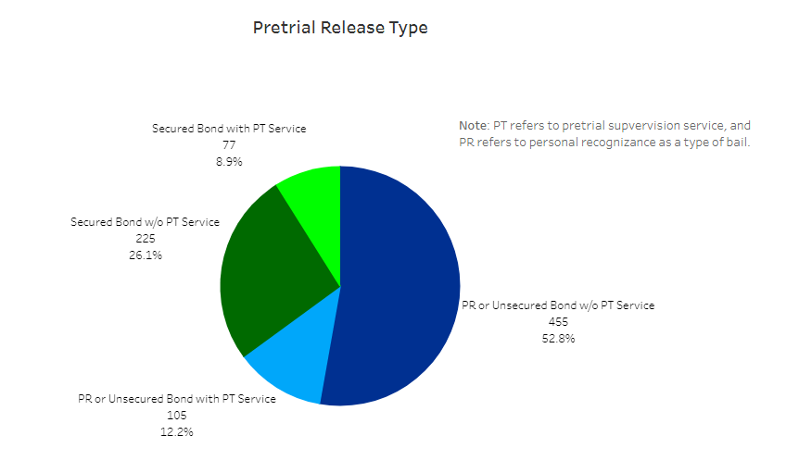
Cities of Buena Vista, Lexington, Staunton, and Waynesboro and the Counties of Augusta and Rockbridge *
Public Defenders Office
Pretrial
Source –
VA Criminal Sentencing Commission

Slide 16
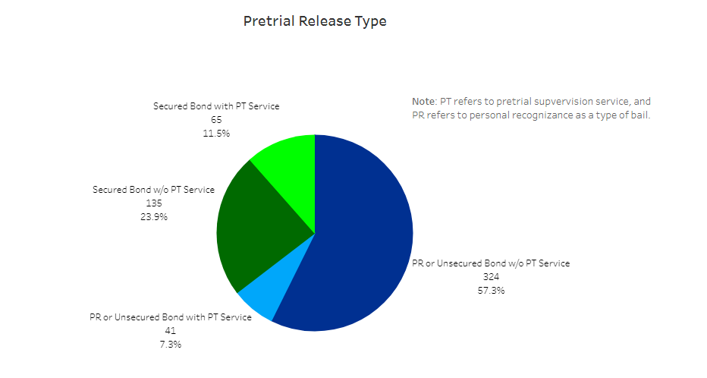
Cities of Buena Vista, Lexington, Staunton, and Waynesboro and the Counties of Augusta and Rockbridge *
Retained by Defendant
Pretrial
Source –
VA Criminal Sentencing Commission

Slide 17
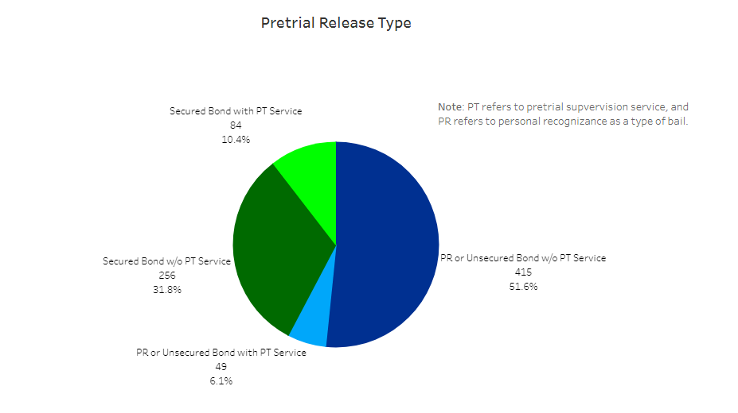
Counties of Clarke, Frederick, Page, Shenandoah, and Warren, and the City of Winchester *
Retained by Client
Pretrial
Source –
VA Criminal Sentencing Commission

Slide 18

Counties of Clarke, Frederick, Page, Shenandoah, and Warren, and the City of Winchester *
Public Defender
Pretrial
Source –
VA Criminal Sentencing Commission

Slide 19
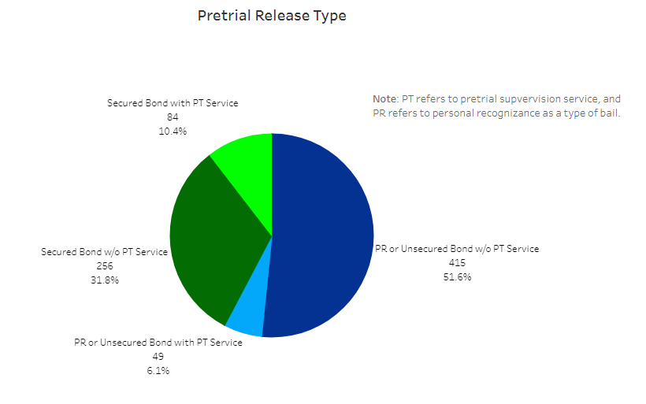
Counties of Clarke, Frederick, Page, Shenandoah, and Warren, and the City of Winchester *
Retained by Client
Pretrial
Source –
VA Criminal Sentencing Commission

